Slide 1
Predictive Client-Side Profiles for Personalized Advertising
Misha Bilenko and Matt Richardson

Slide 2
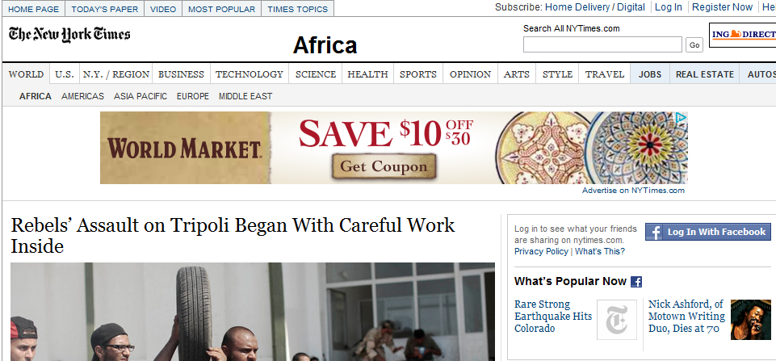
Cookie-cleared User Sees This Ad

Slide 3
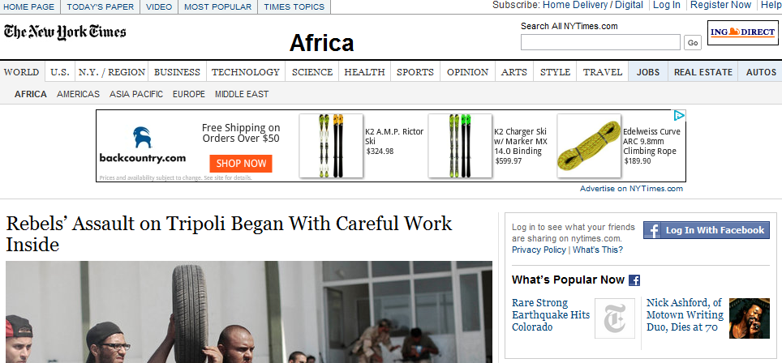
User with Cookies Sees A Different Ad

Slide 4

All Advertising Should Be Personalized
Driven by economics
  Publishers, platforms: average CPM rates 2.7x higher [Beales ‘10]
  Advertisers: 6x gain in CTR [Yao et al. ‘08]
What about users?
  “It’s a little creepy, especially if you don’t know what’s going on” [NYT ‘11]
  Ad industry: users can opt out via
  Privacy advocates: third-party tracking must be regulated
  Browsers: Do Not Track (FF, IE, Safari), KeepMyOptOuts (Chrome)
  Legislation: multiple bills/hearings in US; European e-Privacy directive

Slide 5
This Talk
  Client-side profiles balance ad personalization and user control
  Compact profile construction as an online optimization problem
  Machine learning for profile construction
  Experiments: revenue difference for client-side vs. server-side

Slide 6
Privacy Problem: Lack of Knowledge+Control
Users do not know what is stored, where and why
  Use, retention, sharing
Users cannot edit or delete their behavioral data
  Deleting cookies insufficient: re-identification, LBOs, local storage
  Opting out ≠ having your data purged
  Most users find tracking invasive when asked [McDonald-Cranor ’10]
  But don’t do much about it: Do Not Track adoption in Firefox: 4-6%
Do Not Track regulation proposals misguided, impractical
  Mandatory opt-in toxic to publishers;“3rd party” is a false bogeyman
  Alternative: “Do No Track Server-side”

Slide 7
Server-side User Profiles in Advertising
(query or url)

Slide 8
Server-side User Profiles in Advertising
(query or url)
(ad)

Slide 9
Server-side User Profiles in Advertising
(query or url)
(ad)

Slide 10
Client-only Profiles

Slide 11
Client-only Profiles

Slide 12
Client-only Profiles
+ No plugins (AdNostic, RePRIV, Privad: users install plugins)
+ No major changes to serving infrastructure
+ Targeting server-side (advanced features/algorithms)
+ Profile update server-side (advanced features/algorithms)
+ Platform cost-saving: not paying for profile storage
- Must trust ad platform to comply with policy and not retain
  Debatable proposition for security researchers…
  …but HTTP-header Do Not Track makes the same assumption
  …because we generally trust companies to be law-abiding
  …and it aligns with their long-term incentives

Slide 13
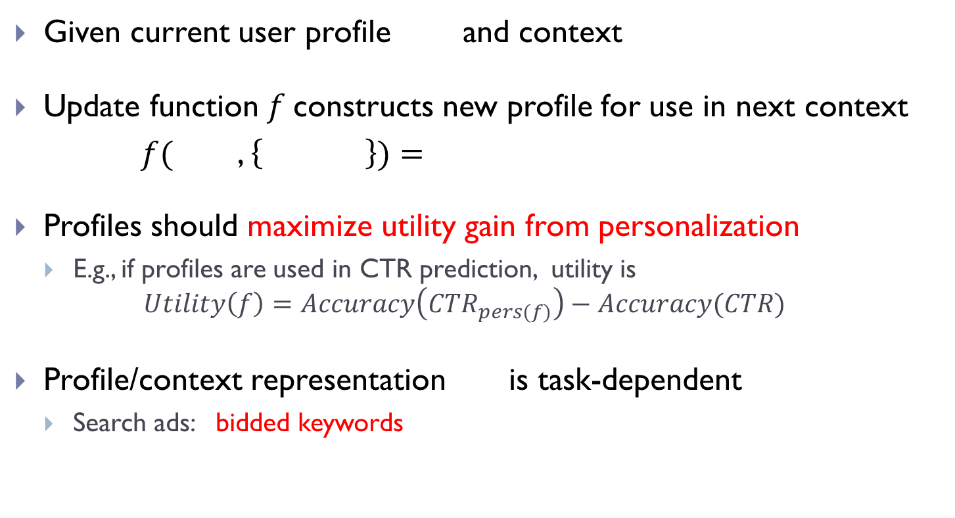
Profile Update: Problem Definition
Given current user profile and context
Update function $f$constructs new profile for use in next context
$f($ , $\left\{ \right\})=$
Profiles should maximize utility gain from personalization
  E.g., if profiles are used in CTR prediction, utility is
  $$Utility\left(f\right)=Accuracy\left(CTR_{pers(f)}\right)−Accuracy(CTR)$$
Profile/context representation is task-dependent
  Search ads: bidded keywords
Query
Ad
Pageview
Click

Slide 14
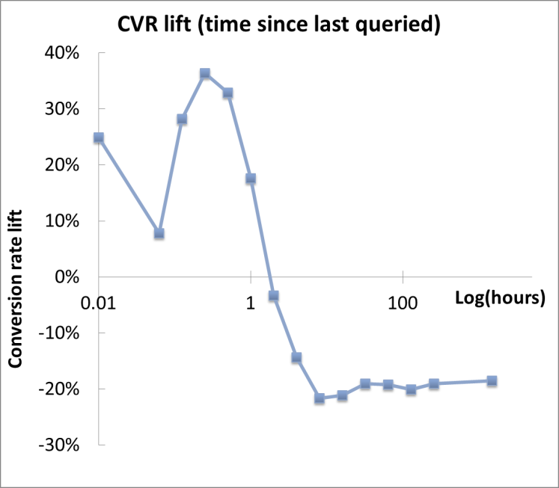
Personalization Modalities in Advertising
Profile uses for ad platforms:
  Selection: profile keywords enhance pool of considered ads
  Allocation: improving CTR prediction, pricing and ranking
Profiles uses for advertisers
  Bid increments: trigger for keyword matching context *and* profile
  Differentiation between casual vs. strong user interest
  Supported by conversion rate trends

Slide 15

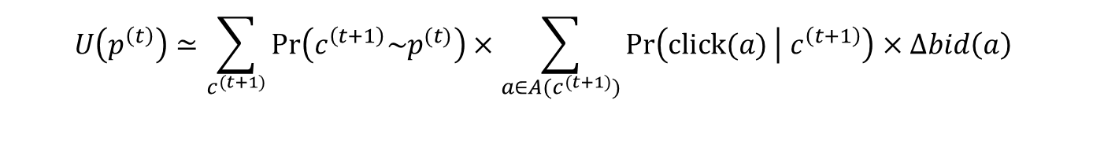
Profile Utility with CPC Bid Increments
Profile utility: additional revenue attributable to the profile
$$U\left(p^{\left(t\right)}\right)=𝔼\left[R\left(p^{\left(t\right)},c^{\left(t_{+}\right)} \right)−R\left(c^{\left(t_{+}\right)} \right)\right]$$
Bid increment utility of a profile is a function of ad inventory:
Revenue with profiles
Revenue without profile (non-personalized)
  $$U\left(p^{\left(t\right)}\right)≃\sum_{c^{(t+1)}}{Pr\left(c^{\left(t+1\right)}\sim p^{(t)}\right)}×\sum_{a∈A(c^{(t+1)})}{Pr\left(click(a) | c^{\left(t+1\right)}\right)×Δbid\left(a\right)}$$
Probability that profile will match future context
Probability of profile-matched ad clicked
Bid increment

Slide 16


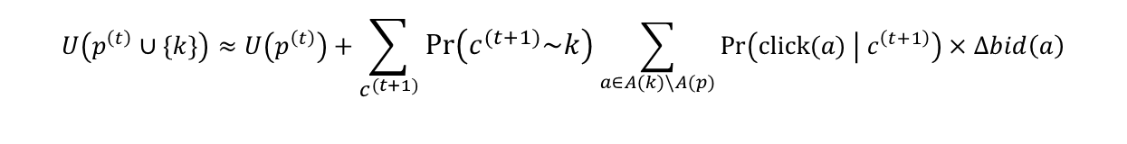
Core Problem: Profile Update
Key observation: bid increment utility is a submodular function of keywords because of (1) broad matching (II) ad campaign coverage
  Adding “Canon SLR” to an empty profile adds more value than adding “Canon SLR” to a profile already containing “Canon 60D”
Basic greedy algorithm is $\left(1−1/e\right)≈63\%$-optimal
  Iteratively add keywords based on their estimated incremental value
  $$U\left(p^{\left(t\right)}∪\{k\}\right)≈U\left(p^{\left(t\right)}\right)+\sum_{c^{(t+1)}}{Pr\left(c^{\left(t+1\right)}\sim k\right)}\sum_{a∈A(k)\backslash A(p)}{Pr\left(click(a) | c^{\left(t+1\right)}\right)×Δbid\left(a\right)}$$
Probability that $k$ is relevant to $c^{(t+1)}$
Probability of being shown and clicked
Bid increment
Newly incremented ads due to this keyword

Slide 17
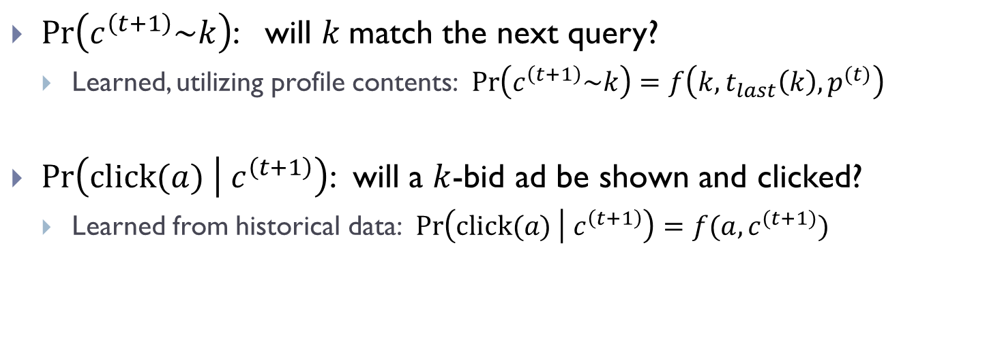
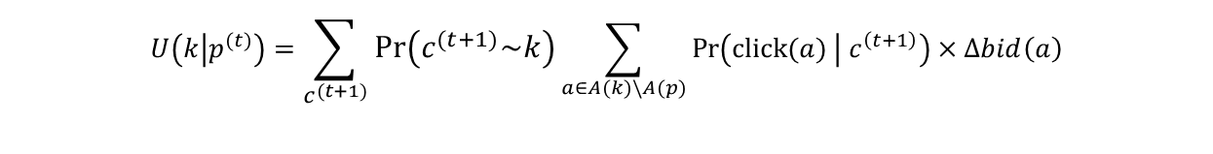
Keyword Utility: Learning to the Rescue
  $$U\left(k | p^{(t)}\right)=\sum_{c^{(t+1)}}{Pr\left(c^{\left(t+1\right)}\sim k\right)}\sum_{a∈A(k)\backslash A(p)}{Pr\left(click(a) | c^{\left(t+1\right)}\right)×Δbid\left(a\right)}$$
Probability that $k$ is relevant to $c^{(t+1)}$
Probability of being shown and clicked
Bid increment
Newly incremented ads due to this keyword
$Pr\left(c^{\left(t+1\right)}\sim k\right)$: will $k$match the next query?
  Learned, utilizing profile contents: $Pr\left(c^{\left(t+1\right)}\sim k\right)=f\left(k,t_{last}\left(k\right),p^{(t)}\right)$
$Pr\left(click(a) | c^{\left(t+1\right)}\right)$: will a $k$-bid ad be shown and clicked?
  Learned from historical data: $Pr\left(click(a) | c^{\left(t+1\right)}\right)=f(a,c^{(t+1)})$

Slide 18
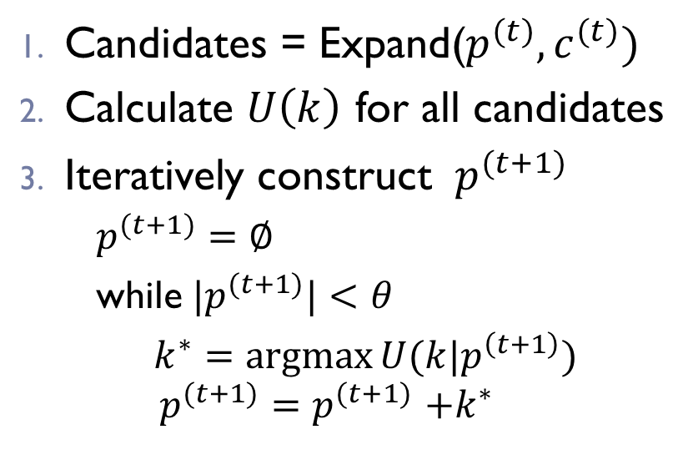
Putting it All Together: Profile Update
Candidates = Expand($p^{(t)},c^{(t)})$
Calculate $U\left(k\right)$ for all candidates
Iteratively construct ${ p}^{(t+1)}$
  $p^{(t+1)}=∅$
  while${ |p}^{(t+1)}|<θ$
    $k^{∗}=\operatorname{argmax}{U(k|p^{\left(t+1\right)})}$
  $$p^{(t+1)}{=p}^{(t+1)}+k^{∗}$$
Key trick: keep a cache of recent contexts with the profile
Used only for expansion, not for charging increments!

Slide 19
Experimental Setup
Replay a large user sample (2.4M) from two months of Bing logs
Profiles constructed online and scored against actual ad clicks
  Pessimistic: underestimates effects from improvements in pClick/ranking
Dataset construction on Cosmos (MapReduce)
  Runs on compressed data on multicore (L-BFGS logistic regression)
Features: frequency/recency, historical counts, decay windows, etc.
$$$ question: how do client-side and server-side profiles compare?
Evaluate the effects of:
  Profile size: used for matching
  Cache size: used for expanding the candidate selection pool

Slide 20
Client-side vs. Server-side Utility
Cache size: number of query events stored client-side
Moderate cache size performs close to optimal

Slide 21
Client-side vs. Server-side vs. Oracle
What % of future user activity can we match at all?
Caveat: depends on matching function (graph)

Slide 22
Conclusions
Client-side profiles balance industry and privacy concerns
Require little change to current ad platform infrastructure
Retain 97+% of server-side personalization revenue gains
Principled utility-based framework for ad personalization
Quantifies gains from offering bid-increments

Slide 23

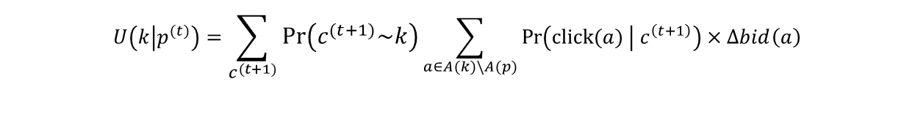
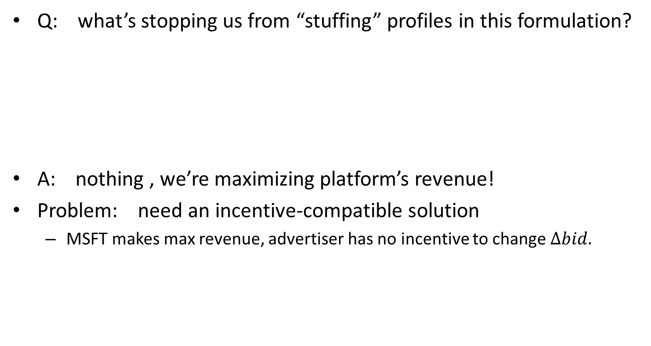
Where Does $ΔBid$ Come From?
Q: what’s stopping us from “stuffing” profiles in this formulation?
A: nothing , we’re maximizing platform’s revenue!
Problem: need an incentive-compatible solution
  MSFT makes max revenue, advertiser has no incentive to change$Δbid.$
  $$U\left(k | p^{(t)}\right)=\sum_{c^{(t+1)}}{Pr\left(c^{\left(t+1\right)}\sim k\right)}\sum_{a∈A(k)\backslash A(p)}{Pr\left(click(a) | c^{\left(t+1\right)}\right)×Δbid\left(a\right)}$$
Probability that $k$ is relevant to $c^{(t+1)}$
Probability of being shown and clicked
Bid increment
Newly incremented ads due to this keyword

Slide 24
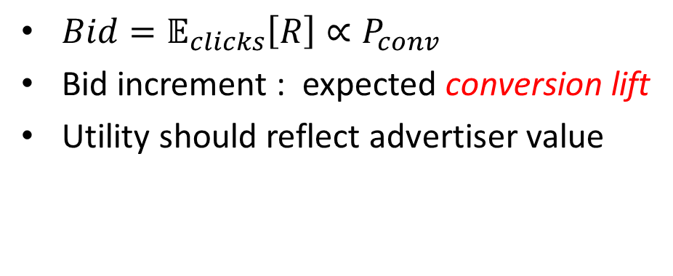
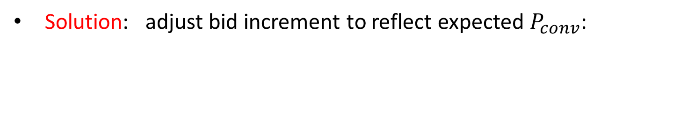
Making Profiles Incentive-Compatible
$Bid=𝔼_{clicks}\left[R\right]∝P_{conv}$
Bid increment : expected conversion lift
Utility should reflect advertiser value
Solution: adjust bid increment to reflect expected $P_{conv}$:
  $$U\left(k | p^{(t)}\right)=Pr\left(c^{\left(t+1\right)}\sim k\right)\sum_{a∈A(k)\backslash A(p)}{Pr\left(click(a) | c^{\left(t+1\right)}\right)×Δbid_{adj}\left(a\right)}$$

Slide 25
More on Trusting the Platform
If I have to trust the server anyway, why not trust it to store my profile as well?
  Trusting not to store is a lower bar than trusting to properly handle profile
Storing profile on server = Trusting any team with access to your profile to:
  Know the policies
  Correctly implement things like opt-out, retention, publication.
  Either never copy your history, or ensure your edits/deletions are propagated through to all copies.
  Not to share it with any other team that might not know these things
Storing profile on client = Trusting just the team that receives the profile to use it and throw it away.

