Slide 1

Fast Prediction of
New Feature Utility
Hoyt Koepke Misha Bilenko

Slide 2
Machine Learning in Practice
Problem formulated as a prediction task
Implement learner, get supervision
Design, refine features
Train, validate,
ship
  To improve accuracy, we can improve:
  Training
  Supervision
  Features

Slide 3
Improving Accuracy By Improving
Training
  Algorithms, objectives/losses, hyper-parameters, …
Supervision
  Cleaning, labeling, sampling, semi-supervised
Representation: refine/induce/add new features
  Most ML engineering for mature applications happens here!
  Process: let’s try this new extractor/data stream/transform/…
    Manual or automatic [feature induction: Della Pietra et al.’97]

Slide 4
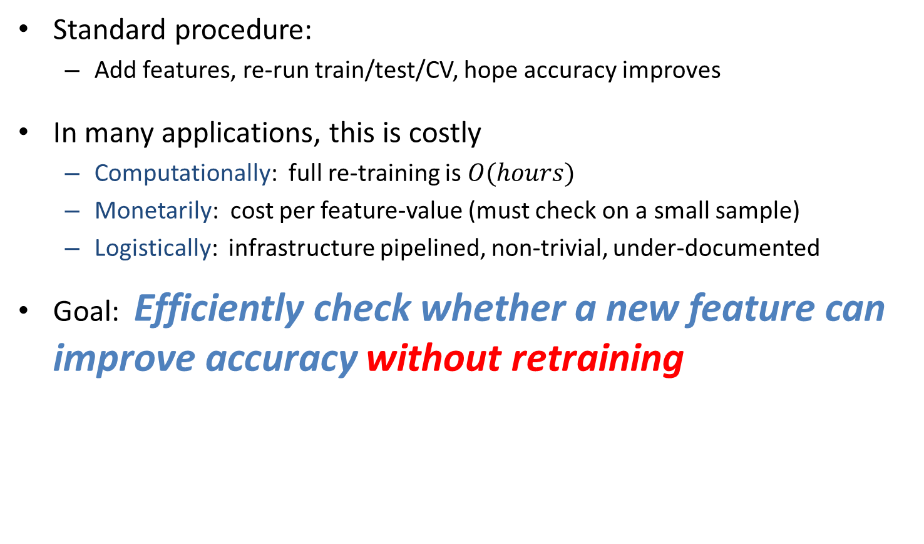
Evaluating New Features
Standard procedure:
  Add features, re-run train/test/CV, hope accuracy improves
In many applications, this is costly
  Computationally: full re-training is $O(hours)$
  Monetarily: cost per feature-value (must check on a small sample)
  Logistically: infrastructure pipelined, non-trivial, under-documented
Goal: Efficiently check whether a new feature can improve accuracy without retraining

Slide 5
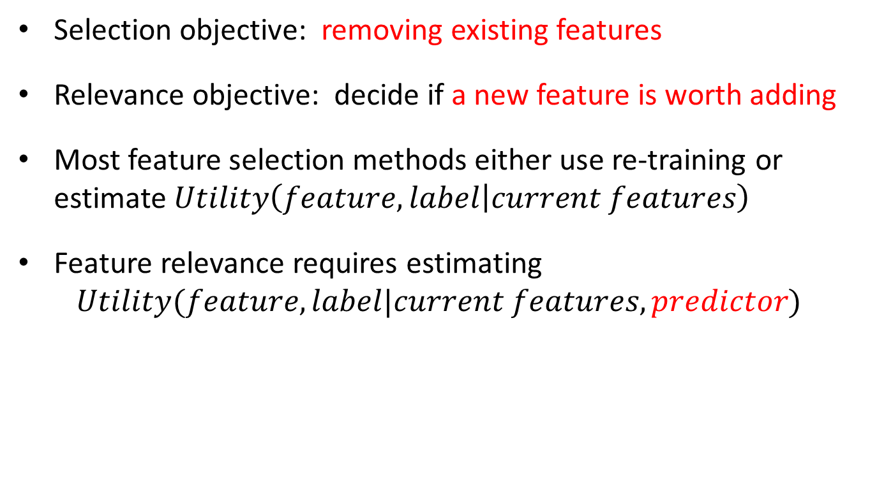

Feature Relevance $≠$Feature Selection
Selection objective: removing existing features
Relevance objective: decide if a new feature is worth adding
Most feature selection methods either use re-training or estimate $Utility\left(feature,label | current features\right)$
Feature relevance requires estimating
$$Utility(feature,label|current features,predictor)$$

Slide 6
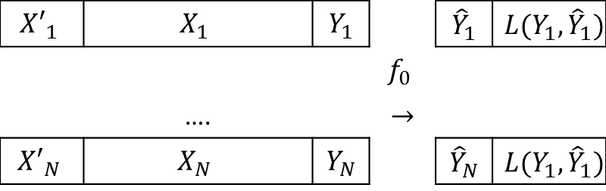

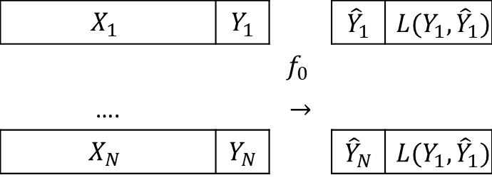
Formalizing New Feature Relevance
Supervised learning setting
  Training set ${\left(X_{i},Y_{i}\right)}_{i=1…N}$
  Current predictor $f_{0}=\underset{f∈ℱ_{𝒳}}{argmin}{𝔼\left[l\left(Y,f\left(X\right)\right)\right]}$=$\underset{f∈ℱ_{𝒳}}{argmin} L(Y,f\left(X\right))$
  New feature $X′$
$${X′}_{1}$$ | $$X_{1}$$ | $$Y_{1}$$ |  | $${\hat{Y}}_{1}$$ | $$L({Y_{1},\hat{Y}}_{1})$$
 |  |  | $$f_{0}$$
 | …. |  | $$→$$
$${X′}_{N}$$ | $$X_{N}$$ | $$Y_{N}$$ |  | $${\hat{Y}}_{N}$$ | $$L({Y_{1},\hat{Y}}_{1})$$
$$X_{1}$$ | $$Y_{1}$$ |  | $${\hat{Y}}_{1}$$ | $$L({Y_{1},\hat{Y}}_{1})$$
 |  | $$f_{0}$$
…. |  | $$→$$
$$X_{N}$$ | $$Y_{N}$$ |  | $${\hat{Y}}_{N}$$ | $$L({Y_{1},\hat{Y}}_{1})$$

Slide 7
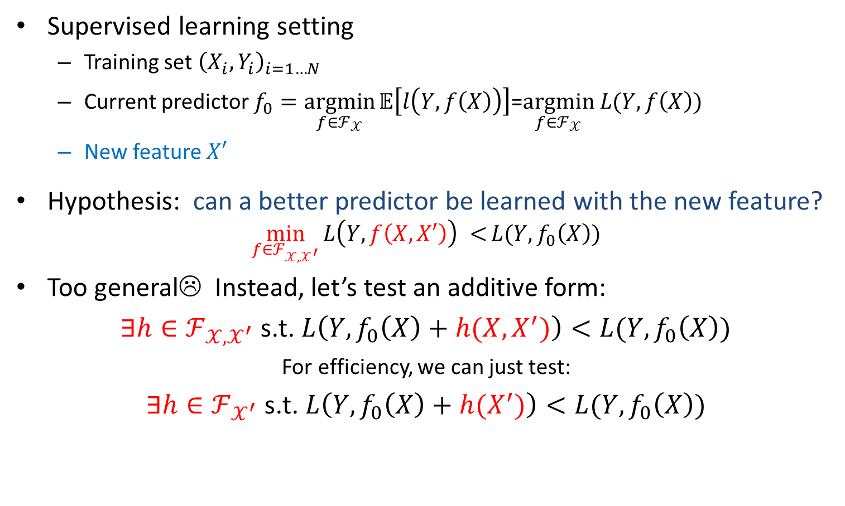
Formalizing New Feature Relevance
Supervised learning setting
  Training set ${\left(X_{i},Y_{i}\right)}_{i=1…N}$
  Current predictor $f_{0}=\underset{f∈ℱ_{𝒳}}{argmin}{𝔼\left[l\left(Y,f\left(X\right)\right)\right]}$=$\underset{f∈ℱ_{𝒳}}{argmin} L(Y,f\left(X\right))$
  New feature $X′$
Hypothesis: can a better predictor be learned with the new feature?
$$\min_{f∈ℱ_{𝒳,𝒳^{′}}}{L\left(Y,f\left(X,X′\right)\right) <}L(Y, f_{0}\left(X\right))$$
Too general☹ Instead, let’s test an additive form:
$∃h∈ℱ_{{𝒳,𝒳}^{′}}$ s.t.$L\left(Y,f_{0}\left(X\right)+h(X,X^{′})\right)<L(Y, f_{0}\left(X\right))$
For efficiency, we can just test:
$∃h∈ℱ_{𝒳^{′}}$ s.t.$L\left(Y,f_{0}\left(X\right)+h(X^{′})\right)<L(Y, f_{0}\left(X\right))$

Slide 8
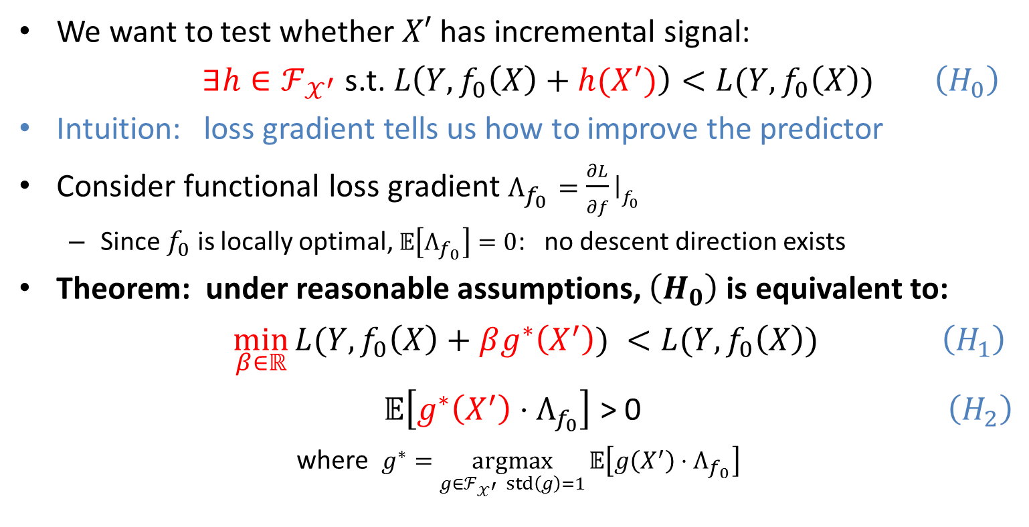
Hypothesis Test for New Feature Relevance
We want to test whether $X′$ has incremental signal:
$∃h∈ℱ_{𝒳^{′}}$ s.t.$L\left(Y,f_{0}\left(X\right)+h(X^{′})\right)<L(Y, f_{0}\left(X\right))$ $\left(H_{0}\right)$
Intuition: loss gradient tells us how to improve the predictor
Consider functional loss gradient $Λ_{f_{0}}=\frac{∂L}{∂f}{\left.​\right|}_{f_{0}}$
  Since $f_{0}$ is locally optimal, $𝔼\left[Λ_{f_{0}}\right]=0$: no descent direction exists
Theorem: under reasonable assumptions, $\left(H_{0}\right)$ is equivalent to:
$\min_{β∈ℝ}{L(Y, f_{0}\left(X\right)+βg^{∗}\left(X^{′}\right)) }<L(Y, f_{0}\left(X\right))$ $\left(H_{1}\right)$
$𝔼\left[g^{∗}\left(X^{′}\right)⋅Λ_{f_{0}}\right]$ > 0 $\left(H_{2}\right)$
where $g^{∗}=\underset{g∈ℱ_{𝒳^{′}} std\left(g\right)=1}{argmax}{𝔼\left[g\left(X^{′}\right)⋅Λ_{f_{0}}\right]}$

Slide 9
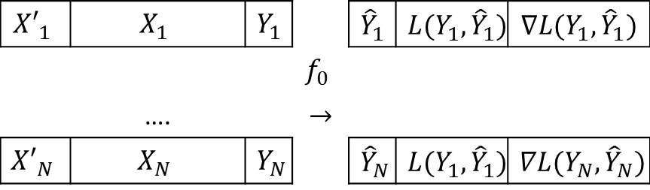
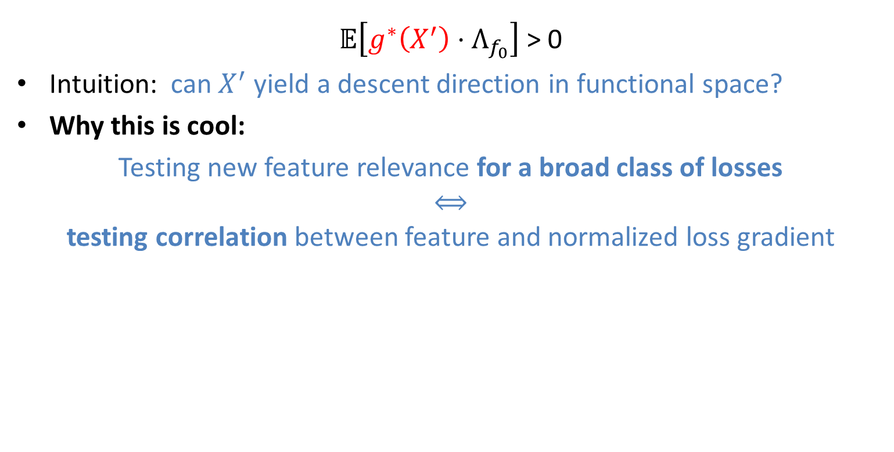
Hypothesis Test for New Feature Relevance
$𝔼\left[g^{∗}\left(X^{′}\right)⋅Λ_{f_{0}}\right]$ > 0
Intuition: can $X^{′}$ yield a descent direction in functional space?
Why this is cool:
Testing new feature relevance for a broad class of losses
⟺
testing correlation between feature and normalized loss gradient
$${X′}_{1}$$ | $$X_{1}$$ | $$Y_{1}$$ |  | $${\hat{Y}}_{1}$$ | $$L({Y_{1},\hat{Y}}_{1})$$ | $$∇L({Y_{1},\hat{Y}}_{1})$$
 |  |  | $$f_{0}$$
 | …. |  | $$→$$
$${X′}_{N}$$ | $$X_{N}$$ | $$Y_{N}$$ |  | $${\hat{Y}}_{N}$$ | $$L({Y_{1},\hat{Y}}_{1})$$ | $$∇L({Y_{N},\hat{Y}}_{N})$$

Slide 10
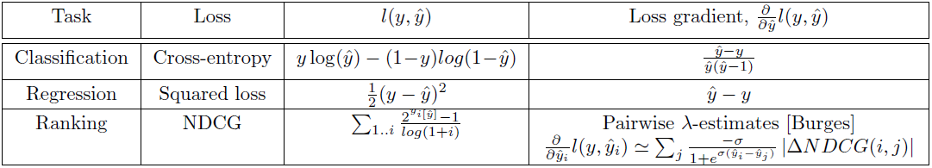
Hypothesis Test for New Feature Relevance
$𝔼\left[g^{∗}\left(X^{′}\right)⋅Λ_{f_{0}}\right]$ > 0
Intuition: can $X^{′}$ yield a descent direction in functional space?
Why this is cool:
Testing new feature relevance for a broad class of losses
⟺
testing correlation between feature and normalized loss gradient

Slide 11
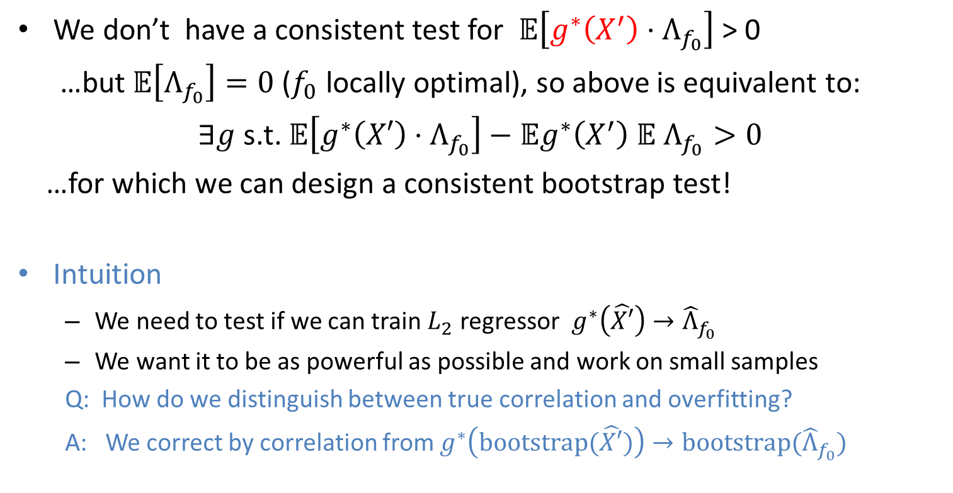
Testing Correlation to Loss Gradient
We don’t have a consistent test for $𝔼\left[g^{∗}\left(X^{′}\right)⋅Λ_{f_{0}}\right]$ > 0
…but $𝔼\left[Λ_{f_{0}}\right]=0$ ($f_{0}$ locally optimal), so above is equivalent to:
$∃g$ s.t. $𝔼\left[g^{∗}\left(X′\right)⋅Λ_{f_{0}}\right]−𝔼g^{∗}\left(X^{′}\right) 𝔼 Λ_{f_{0}}>0$
…for which we can design a consistent bootstrap test!
Intuition
  We need to test if we can train $L_{2}$ regressor $g^{∗}\left(\hat{X′}\right)→{\hat{Λ}}_{f_{0}}$
  We want it to be as powerful as possible and work on small samples
  Q: How do we distinguish between true correlation and overfitting?
  A: We correct by correlation from $g^{∗}\left(bootstrap(\hat{X′})\right)→bootstrap({\hat{Λ}}_{f_{0}})$

Slide 12
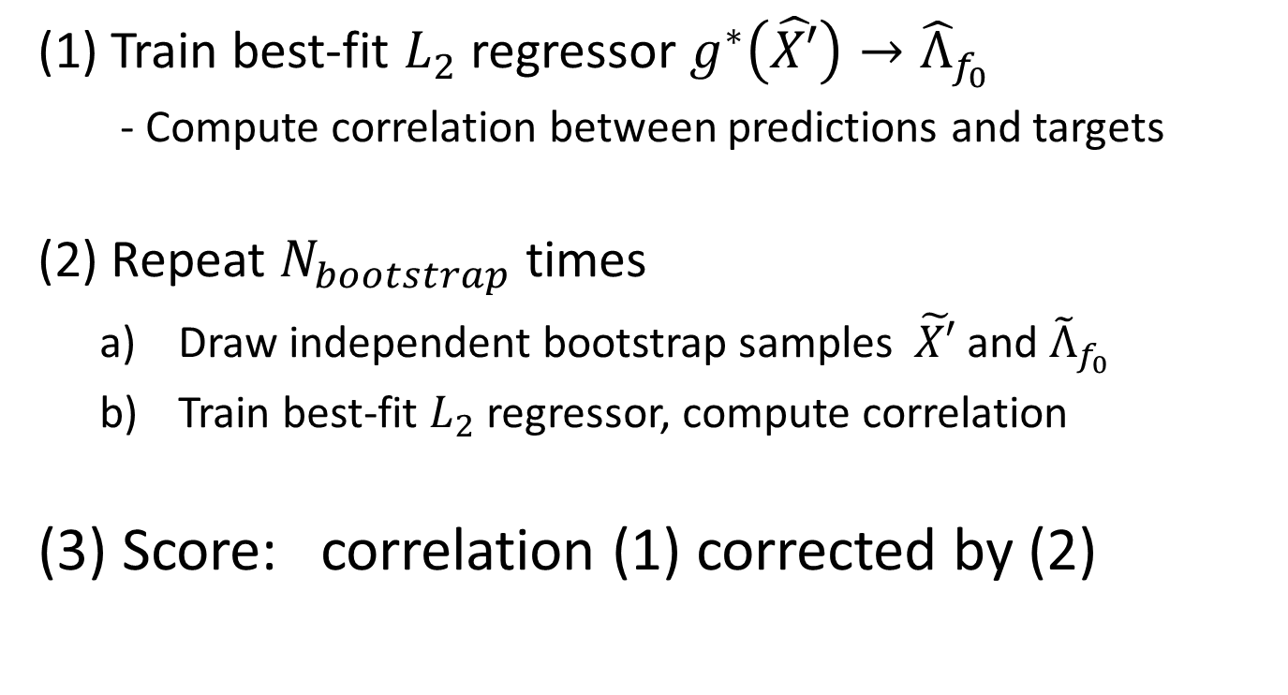
New Feature Relevance: Algorithm
(1) Train best-fit $L_{2}$regressor $g^{∗}\left(\hat{X′}\right)→{\hat{Λ}}_{f_{0}}$
  - Compute correlation between predictions and targets
(2) Repeat $N_{bootstrap}$ times
  Draw independent bootstrap samples $\tilde{X′}$ and ${\tilde{Λ}}_{f_{0}}$
  Train best-fit $L_{2}$regressor, compute correlation
(3) Score: correlation (1) corrected by (2)

Slide 13
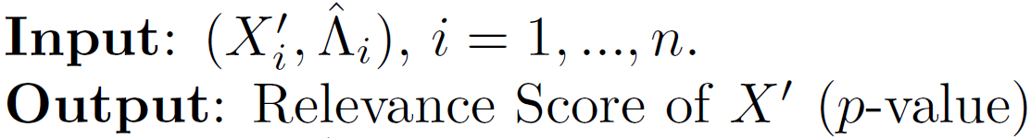


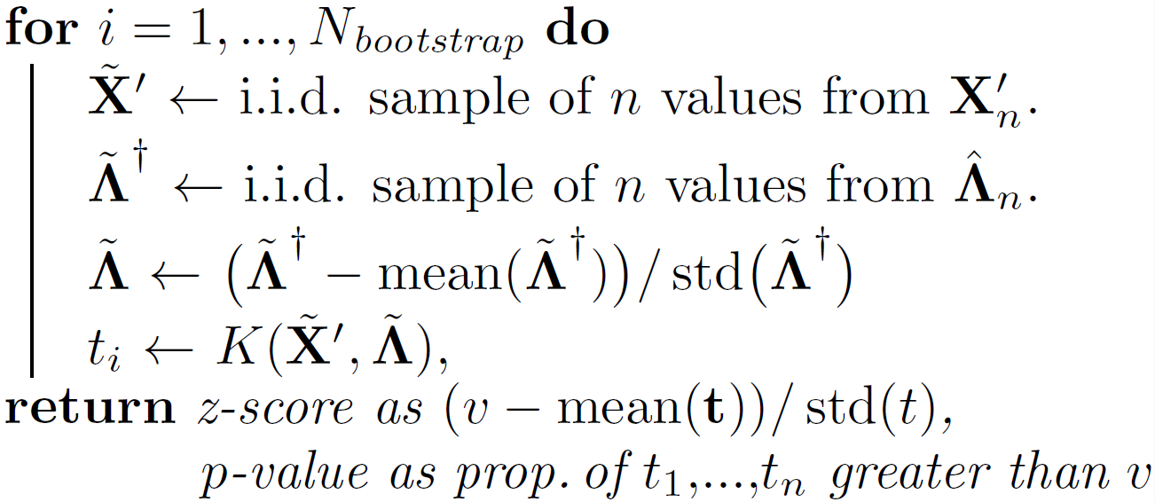
New Feature Relevance: Algorithm

Slide 14
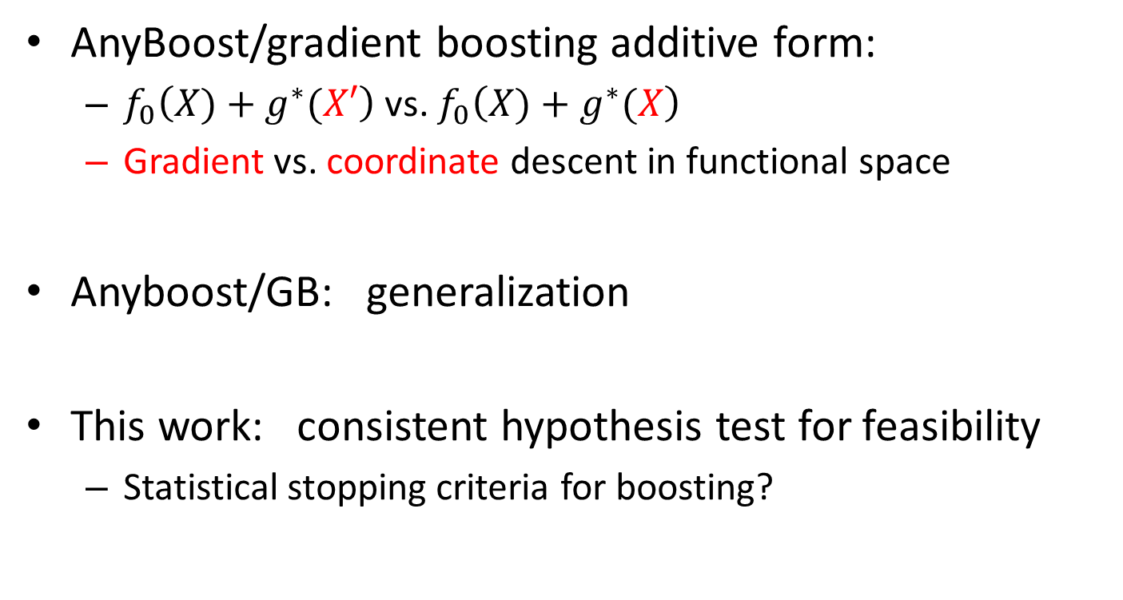
Connection to Boosting
AnyBoost/gradient boosting additive form:
  $f_{0}\left(X)+g^{∗}(X′\right)$ vs. $f_{0}\left(X)+g^{∗}(X\right)$
  Gradient vs. coordinate descent in functional space
Anyboost/GB: generalization
This work: consistent hypothesis test for feasibility
  Statistical stopping criteria for boosting?

Slide 15
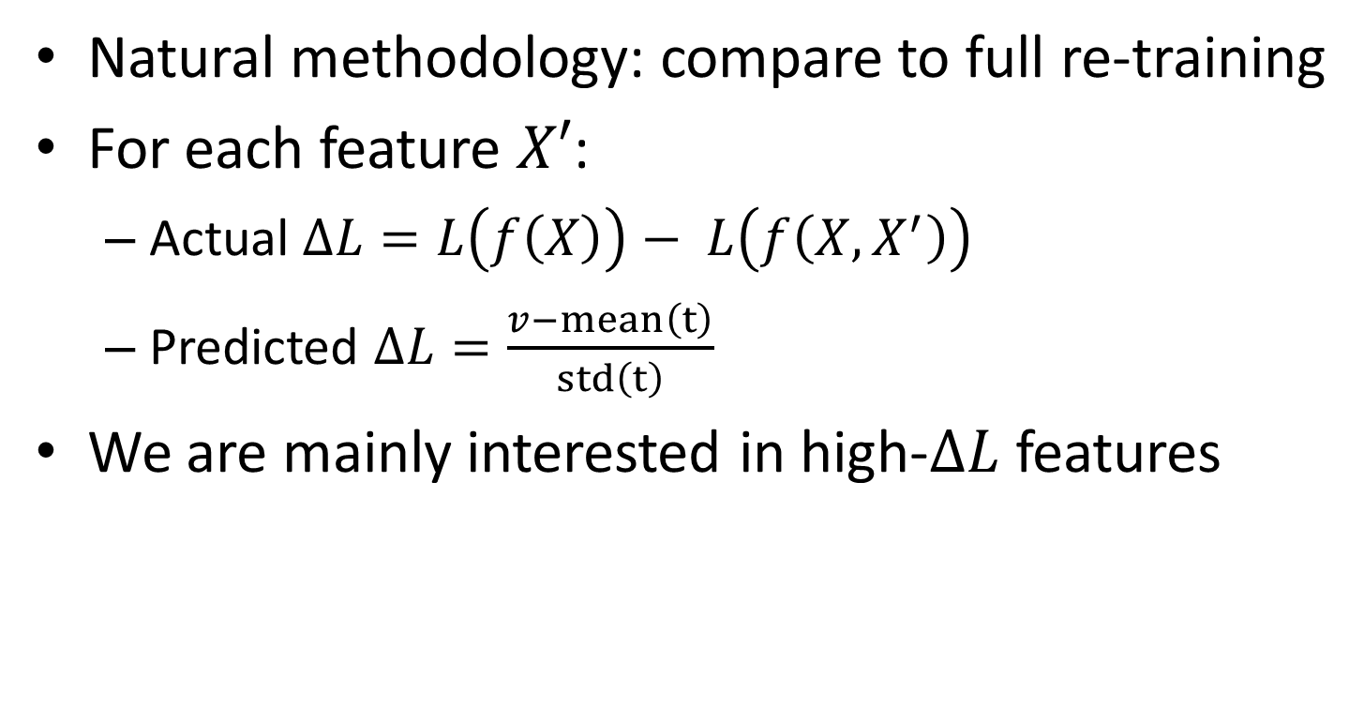
Experimental Validation
Natural methodology: compare to full re-training
For each feature $X′$:
  Actual $∆L=L\left(f\left(X\right)\right)− L\left(f\left(X,X^{′}\right)\right)$
  Predicted $∆L=\frac{v−mean\left(t\right)}{std\left(t\right)}$
We are mainly interested in high-$∆L$ features

Slide 16
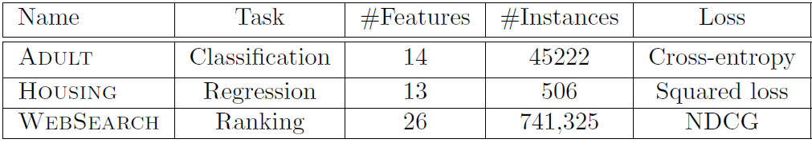
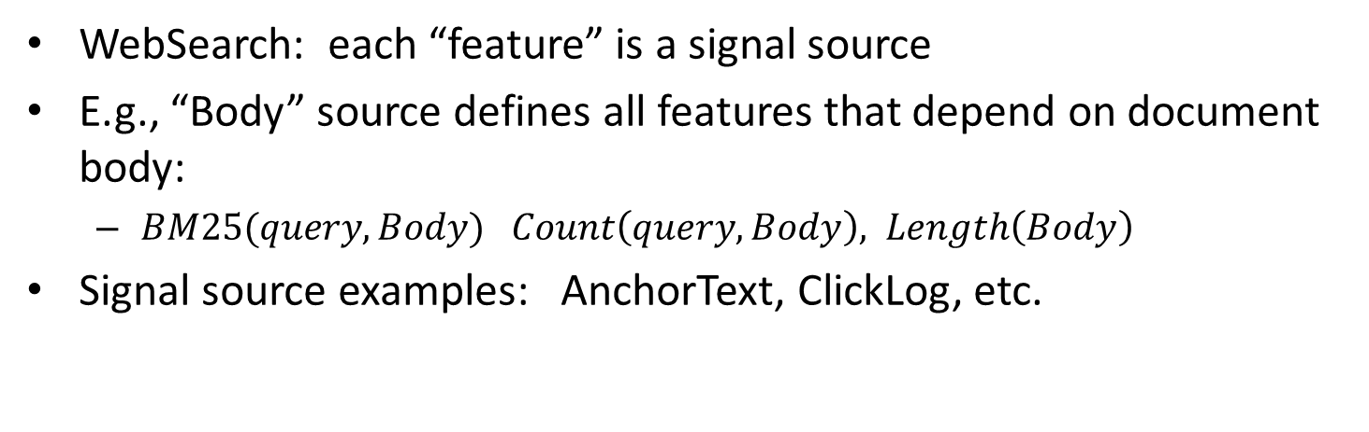
Datasets
WebSearch: each “feature” is a signal source
E.g., “Body” source defines all features that depend on document body:
  $BM25(query,Body)$ $Count\left(query,Body\right), Length\left(Body\right)$
Signal source examples: AnchorText, ClickLog, etc.

Slide 17
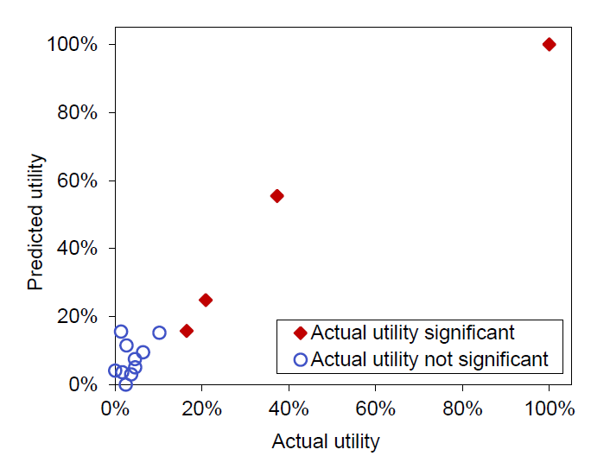
Results: Adult

Slide 18
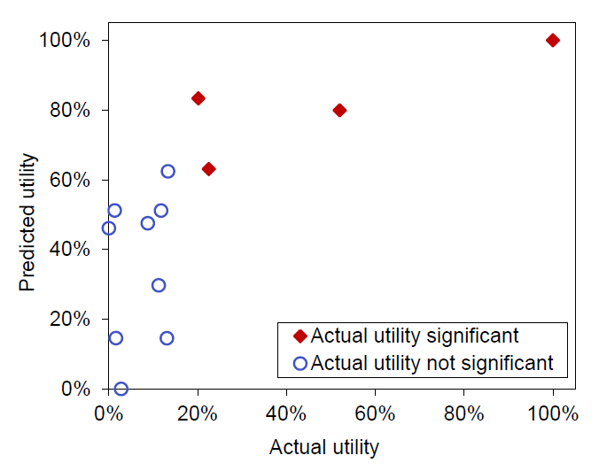
Results: Housing

Slide 19
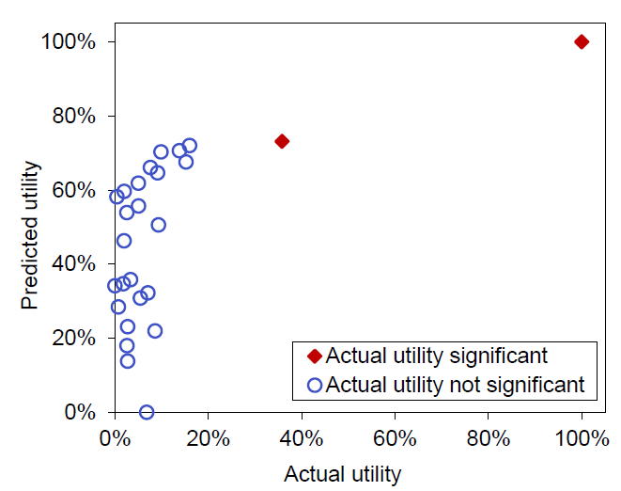
Results: WebSearch

Slide 20
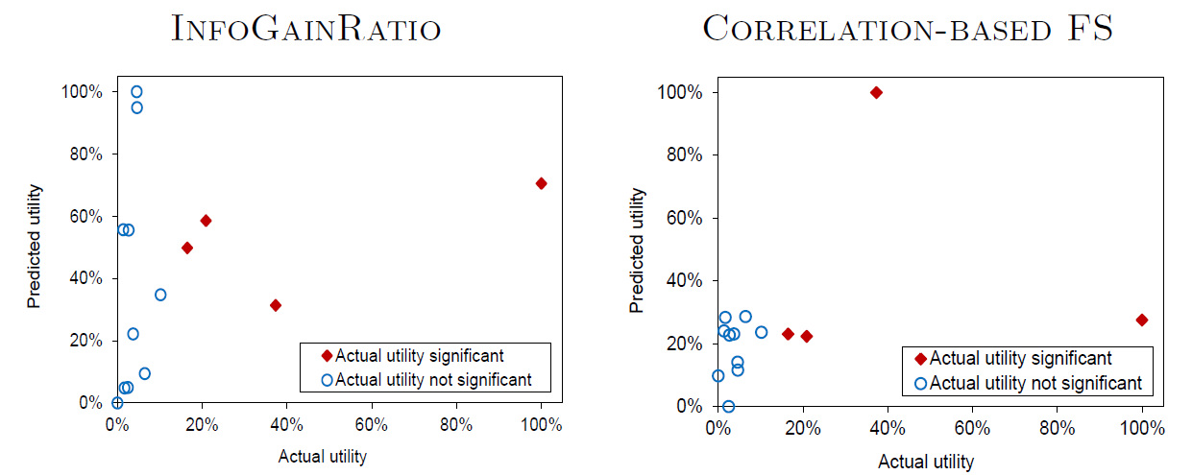
Comparison to Feature Selection

Slide 21
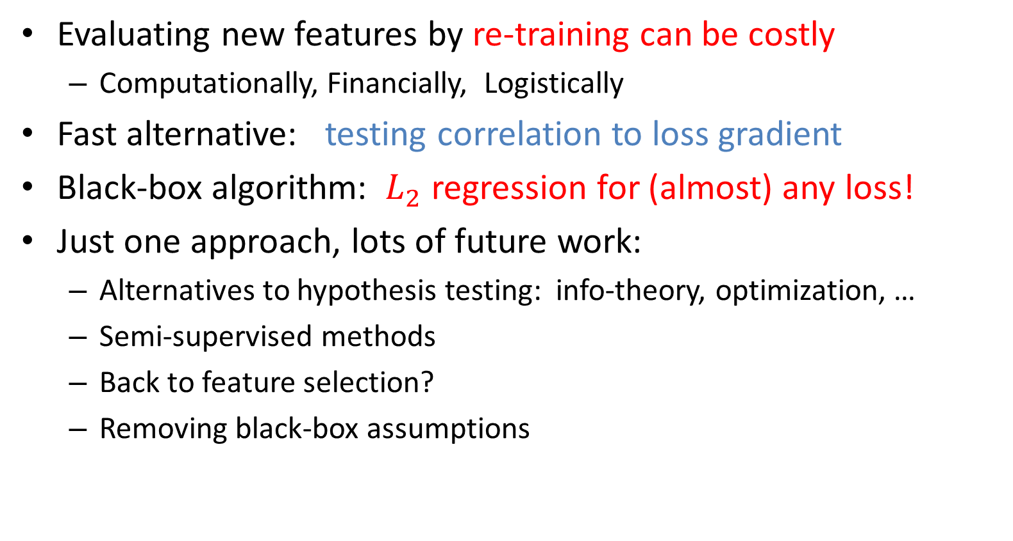
New Feature Relevance: Summary
Evaluating new features by re-training can be costly
  Computationally, Financially, Logistically
Fast alternative: testing correlation to loss gradient
Black-box algorithm: $L_{2}$ regression for (almost) any loss!
Just one approach, lots of future work:
  Alternatives to hypothesis testing: info-theory, optimization, …
  Semi-supervised methods
  Back to feature selection?
  Removing black-box assumptions

