Slide 1
Lazy Paired Hyper-Parameter Tuning
Alice Zheng and Misha Bilenko
Microsoft Research, Redmond
Aug 7, 2013 (IJCAI ’13)

Slide 2
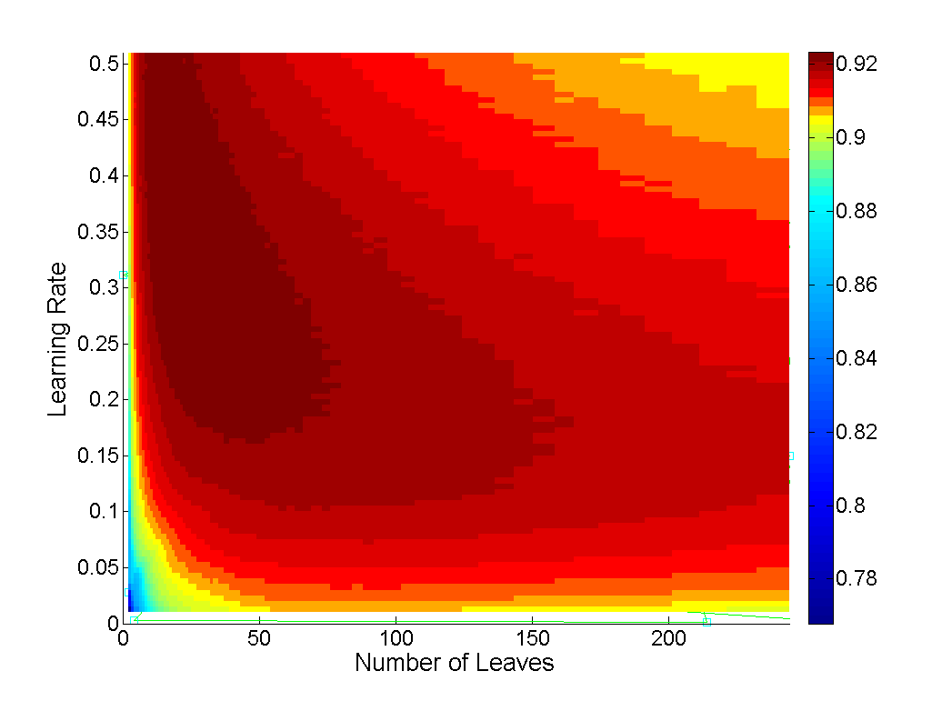
Dirty secret of machine learning: Hyper-parameters
Hyper-parameters: settings of a learning algorithm
Tree ensembles (boosting, random forest): #trees, #leaves, learning rate, …
Linear models (perceptron, SVM): regularization, learning rate, …
Neural networks: #hidden units, #layers, learning rate, momentum, …
Hyper-parameters can make a difference in learned model accuracy
Example: AUC of boosted trees
on Census dataset (income prediction)

Slide 3



Hyper-parameter auto-tuning
Hyper-Parameter Tuner
$$α$$
Training
Data
Learner
Learner accuracy $g(f_{α})$
Learned model $f_{α}$
Validation
Data
Validator

Slide 4


Hyper-parameter auto-tuning
Hyper-Parameter Tuner
Best hyper-param $α^{∗}$
$$α$$
Training
Data
Learner
Learner accuracy $g(f_{α})$
Learned model $f_{α}$
Validation
Data
Validator

Slide 5


Hyper-parameter auto-tuning
Hyper-Parameter Tuner
Best hyper-param $α^{∗}$
$$α$$
Training
Data
Learner
Learner accuracy $\hat{g}(f_{α},D)$
Finite, noisy samples
Learned model $f_{α}$
Stochastic estimate
Validation
Data
Validator

Slide 6
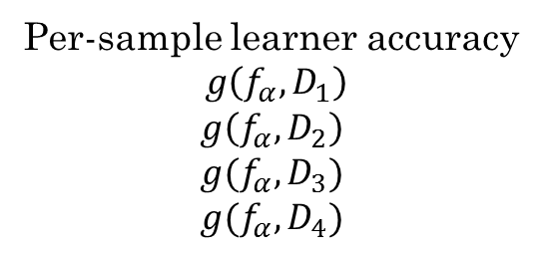
Dealing with noise
Hyper-Parameter Tuner
Best hyper-param $α^{∗}$
$$α$$
Training
Data
Training
Data
Training
Data
Per-sample learner accuracy
$$g\left(f_{α},D_{1}\right)$$
$$g\left(f_{α},D_{2}\right)$$
$$g(f_{α},D_{3})$$
$$g(f_{α},D_{4})$$
Training
Data
Noisy
Learner
Cross-validation
or
boostrap
Validation
Data
Learned model $f_{α}$
Validation
Data
Validation
Data
Validation
Data
Validator

Slide 7

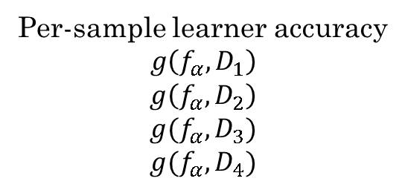
Black-box tuning
Hyper-Parameter Tuner
Best hyper-param $α^{∗}$
$$α$$
(Noisy)
Black Box
Per-sample learner accuracy
$$g\left(f_{α},D_{1}\right)$$
$$g\left(f_{α},D_{2}\right)$$
$$g(f_{α},D_{3})$$
$$g(f_{α},D_{4})$$
Training
Data
Learner
Learned model $f_{α}$
Validation
Data
Validator

Slide 8
Computational challenges
Problem: train-test black-box has noisy (stochastic) output
Solution:
Take multiple evaluations and average
Generate multiple training/validation datasets via cross-validation or bootstrap
Repeated for every candidate setting proposed by the hyper-parameter tuner
Computationally expensive

Slide 9
Q: How to EFFICIENTLY tune a STOCHASTIC black box?
Is full cross-validation required for every hyper-parameter candidate setting?

Slide 10
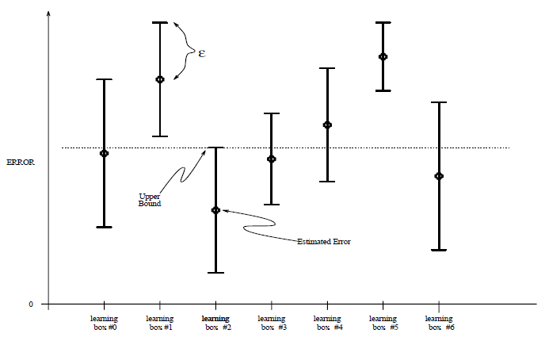
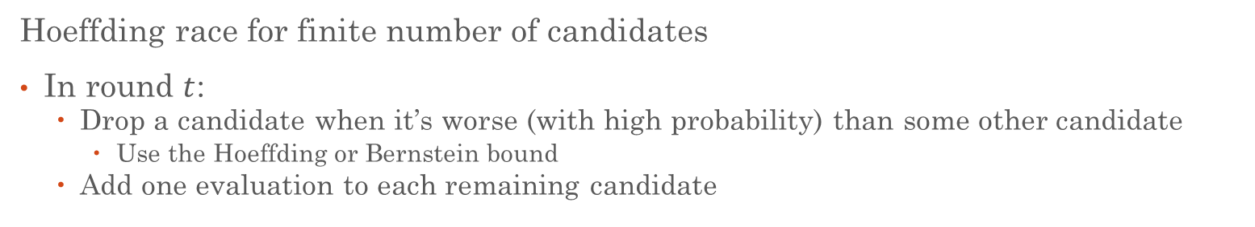
Prior approaches
Hoeffding race for finite number of candidates
In round $t$:
Drop a candidate when it’s worse (with high probability) than some other candidate
Use the Hoeffding or Bernstein bound
Add one evaluation to each remaining candidate
Illustration of Hoeffding Racing (source: Maron & Moore, 1994)

Slide 11
Prior approaches
Bandit algorithms for online learning
UCB1:
Evaluate the candidate with the highest upper bound on reward
Based on the Hoeffding bound (with time-varying threshold)
EXP3:
Maintain a soft-max distribution of cumulative reward
Randomly select a candidate to evaluate based on this distribution

Slide 12

A better approach
Some tuning methods only need pairwise comparison information
Is configuration $x$ better than or worse than configuration $y$?
Use matched statistical tests to compare candidates in a race
Statistically more efficient than bounding single candidates

Slide 13
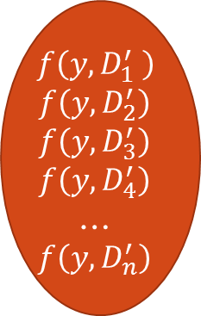
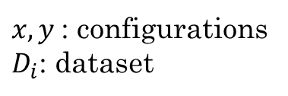
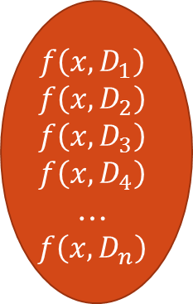
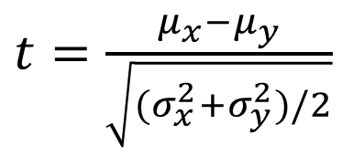
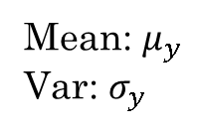
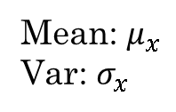
Pairwise unmatched T-test
$$f\left(x,D_{1}\right)$$
$$f\left(x,D_{2}\right)$$
$$f\left(x,D_{3}\right)$$
$$f\left(x,D_{4}\right)$$
…
$$f\left(x,D_{n}\right)$$
$$f\left(y,D_{1}^{′} \right)$$
$$f\left(y,D_{2}^{′}\right)$$
$$f\left(y,D_{3}^{′}\right)$$
$$f\left(y,D_{4}^{′}\right)$$
…
$$f\left(y,D_{n}^{′}\right)$$
$x, y$: configurations
$D_{i}$: dataset
Mean: $μ_{x}$
Var: $σ_{x}$
Mean: $μ_{y}$
Var: $σ_{y}$
$t=\frac{μ_{x}−μ_{y}}{\sqrt{(σ_{x}^{2}+σ_{y}^{2})/2}}$

Slide 14
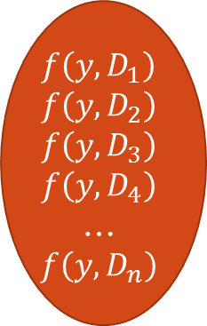

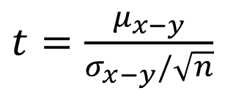
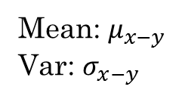
Pairwise matched T-test
$$f\left(x,D_{1}\right)$$
$$f\left(x,D_{2}\right)$$
$$f\left(x,D_{3}\right)$$
$$f\left(x,D_{4}\right)$$
…
$$f\left(x,D_{n}\right)$$
$$f\left(y,D_{1}\right)$$
$$f\left(y,D_{2}\right)$$
$$f\left(y,D_{3}\right)$$
$$f\left(y,D_{4}\right)$$
…
$$f\left(y,D_{n}\right)$$
$x, y$: configurations
$D_{i}$: dataset
Mean: $μ_{x−y}$
Var: $σ_{x−y}$
$t=\frac{μ_{x−y}}{σ_{x−y}/\sqrt{n}}$

Slide 15
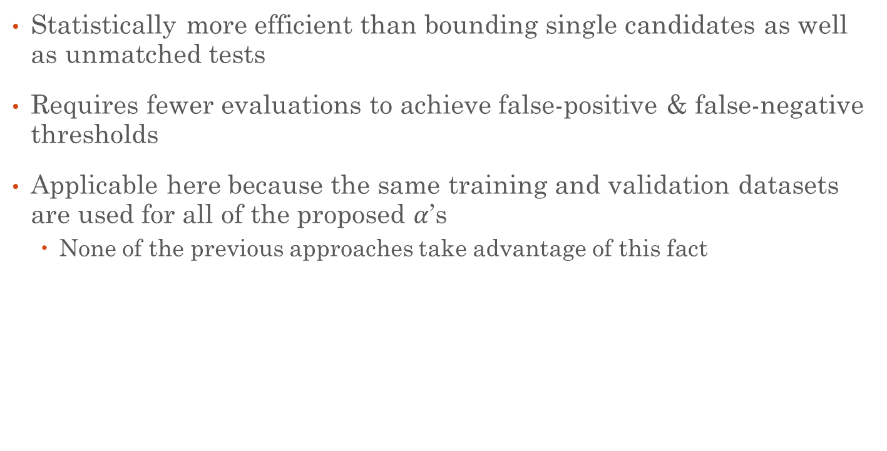
Advantage of matched tests
Statistically more efficient than bounding single candidates as well as unmatched tests
Requires fewer evaluations to achieve false-positive & false-negative thresholds
Applicable here because the same training and validation datasets are used for all of the proposed $α$’s
None of the previous approaches take advantage of this fact

Slide 16
Lazy evaluations
Idea 2: Only perform as many evaluations as is needed to tell apart a pair of configurations
Perform power analysis on the T-test

Slide 17
What is power analysis?
 | Predicted as True | Predicted as False
True | True Positives | False Negatives
False | False Positives | True Negatives
Dominant configuration predicted as tied
Tied configurations, one is falsely predicted dominant
Hypothesis testing:
Guarantees a false positive rate—good configurations won’t be falsely eliminated
Power analysis:
For a given false negative tolerance, how many evaluations do we need in order to declare that one configuration dominates another?

Slide 18
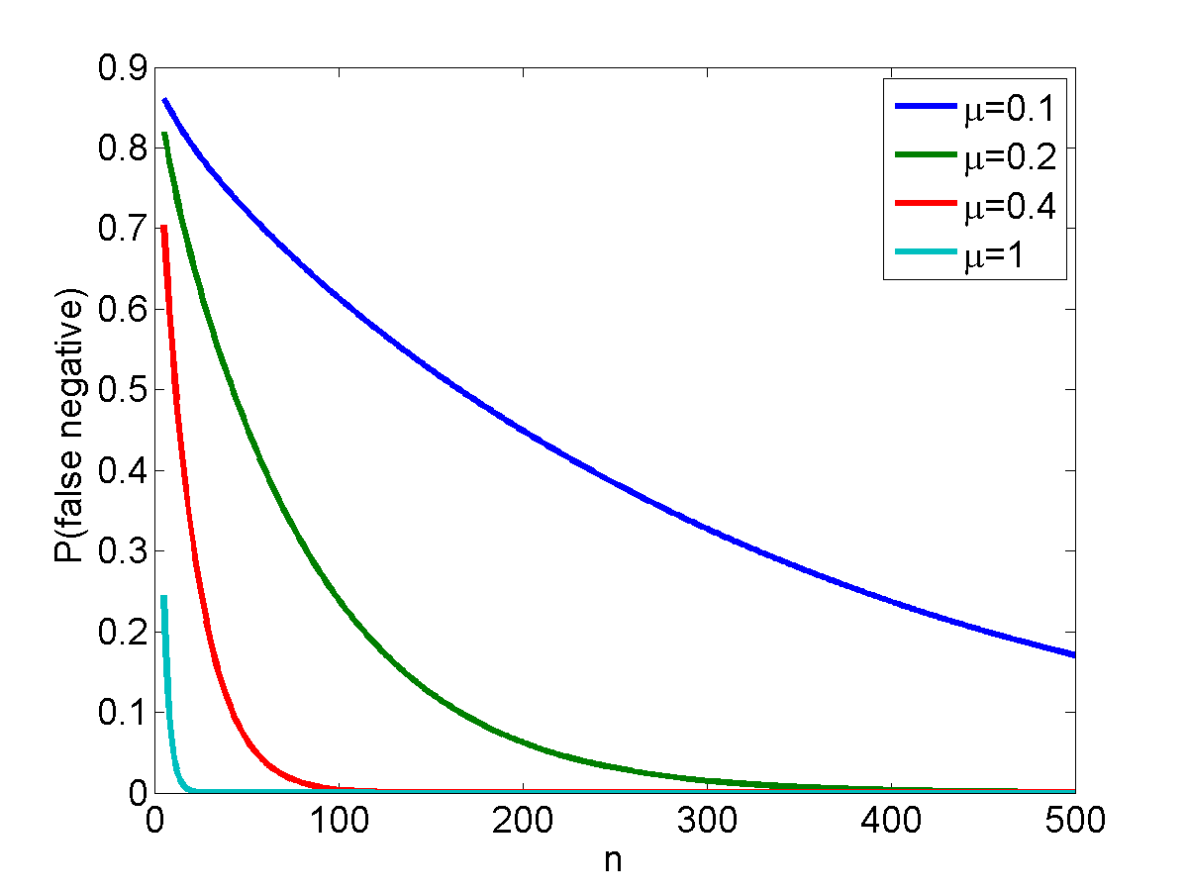
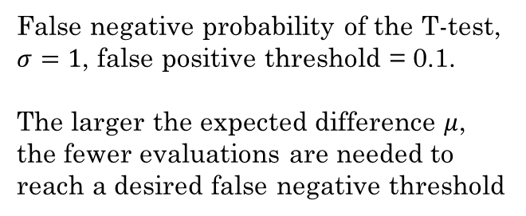
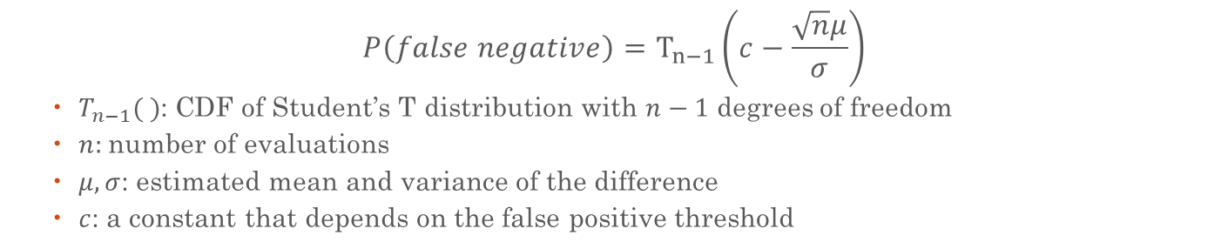
Power analysis of T-test
$$P\left(false negative\right)=T_{n−1}\left(c−\frac{\sqrt{n}μ}{σ}\right)$$
$T_{n−1}( )$: CDF of Student’s T distribution with $n−1$ degrees of freedom
$n:$number of evaluations
$μ, σ$: estimated mean and variance of the difference
$c$: a constant that depends on the false positive threshold
False negative probability of the T-test,
$σ=1$, false positive threshold = 0.1.
The larger the expected difference $μ$,
the fewer evaluations are needed to
reach a desired false negative threshold

Slide 19
Algorithm LaPPT
Given finite number of hyper-parameter configurations
Start with a few initial evaluations
Repeat until a single candidate remains or evaluation budget is exhausted
Perform pairwise t-test among current candidates
If a test returns “not equal”
remove dominated candidate
If a test returns “probably equal”
estimate how many additional evaluations are needed to establish dominance (power analysis)
Perform additional evaluations for leading candidates

Slide 20
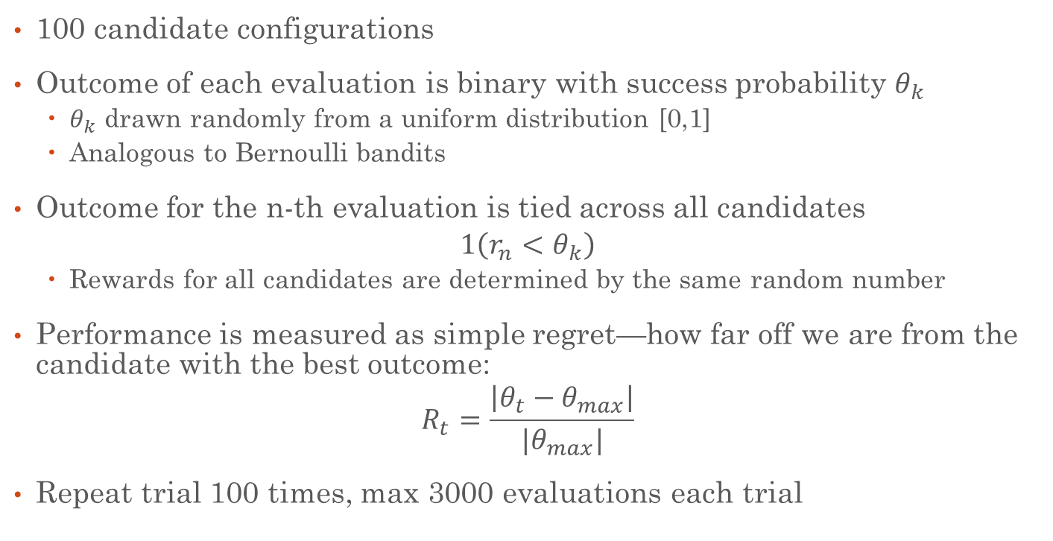
Experiment 1: Bernoulli candidates
100 candidate configurations
Outcome of each evaluation is binary with success probability $θ_{k}$
$θ_{k}$ drawn randomly from a uniform distribution [0,1]
Analogous to Bernoulli bandits
Outcome for the n-th evaluation is tied across all candidates
$$1\left(r_{n}<θ_{k}\right)$$
Rewards for all candidates are determined by the same random number
Performance is measured as simple regret—how far off we are from the candidate with the best outcome:
$$R_{t}=\frac{\left|θ_{t}−θ_{max}\right|}{|θ_{max}|}$$
Repeat trial 100 times, max 3000 evaluations each trial

Slide 21
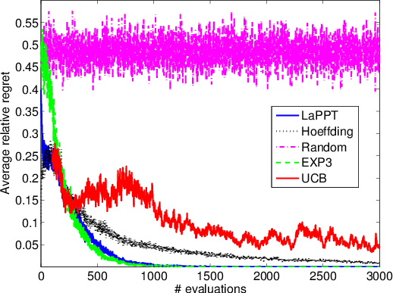
Experiment 1: Results
Best to worst:
LaPPT, EXP3
Hoeffding racing
UCB
Random
BETTER

Slide 22
Experiment 2: Real learners
Learner 1: Gradient boosted decision trees
Learning rate for gradient boosting
Number of trees
Maximum number of leaves per tree
Minimum number of instances for a split
Learner 2: Logistic regression
L1 penalty
L2 penalty
Randomly sample 100 configurations, evaluate each up to 50 CV folds

Slide 23
Experiment 2: UCI datasets
Dataset | Task | Performance Metric
Adult Census | Binary classification | AUC
Housing | Regression | L1 error
Waveform | Multiclass classification | Cross-entropy

Slide 24
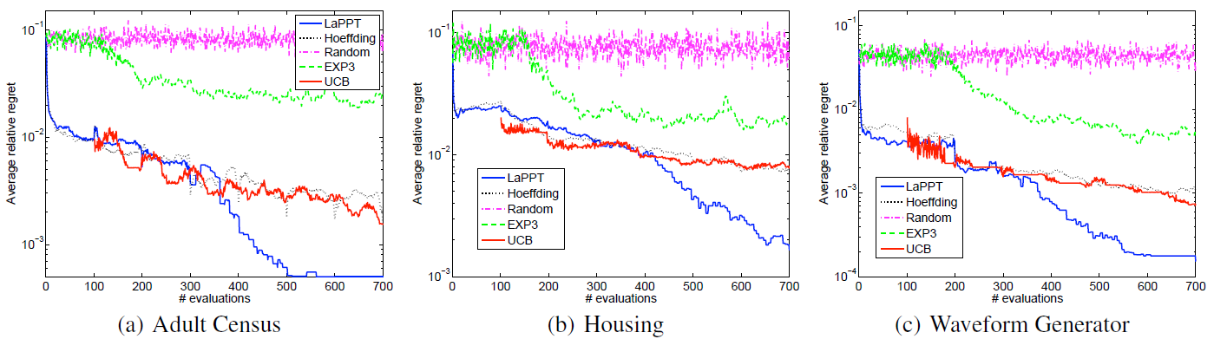
Experiment 2: Tree learner results
Best to worst: LaPPT, {UCB, Hoeffding}, EXP3, Random
LaPPT quickly narrows down to only 1 candidate, Hoeffding is very slow to eliminate anything
Similar results similar for logistic regression

Slide 25
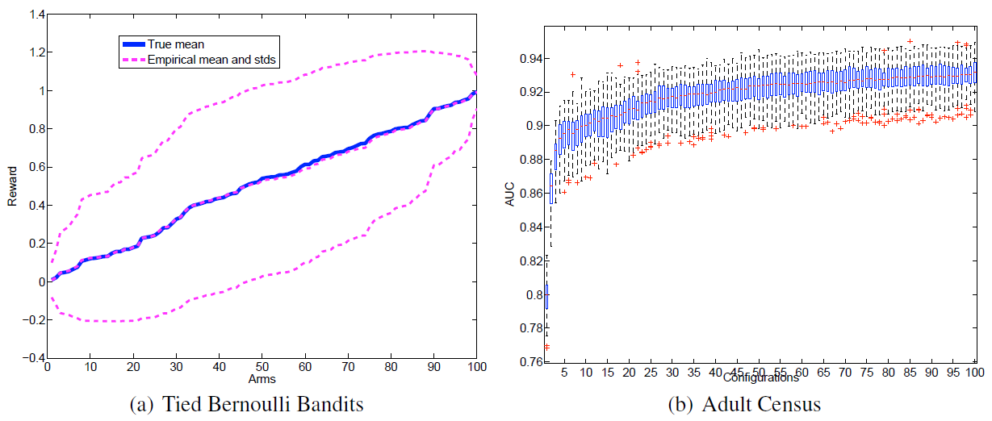
Why is LaPPT so much better?
Distribution of real learning algorithm performance is VERY different from Bernoulli
Confuses some bandit algorithms

Slide 26
Other advantages
More efficient tests
Hoeffding racing uses the Hoeffding/Bernstein bound
Very loose tail probability bound of a single random variable
Pairwise statistical tests are more efficient
Requires fewer evaluations to obtain an answer
Lazy evaluations
LaPPT performs only the necessary evaluations

Slide 27
Experiment 3: Continuous hyper-parameters
When the hyper-parameters are real-valued, there are infinitely many candidates
Hoeffding racing and classic bandit algorithms no longer apply
LaPPT can be combined with a directed search method
Nelder-Mead: most popular gradient-free search method
Uses a simplex of candidate points to compute a search direction
Only requires pairwise comparisons—good fit for LaPPT
Experiment 3: Apply NM+LaPPT on Adult Census dataset

Slide 28
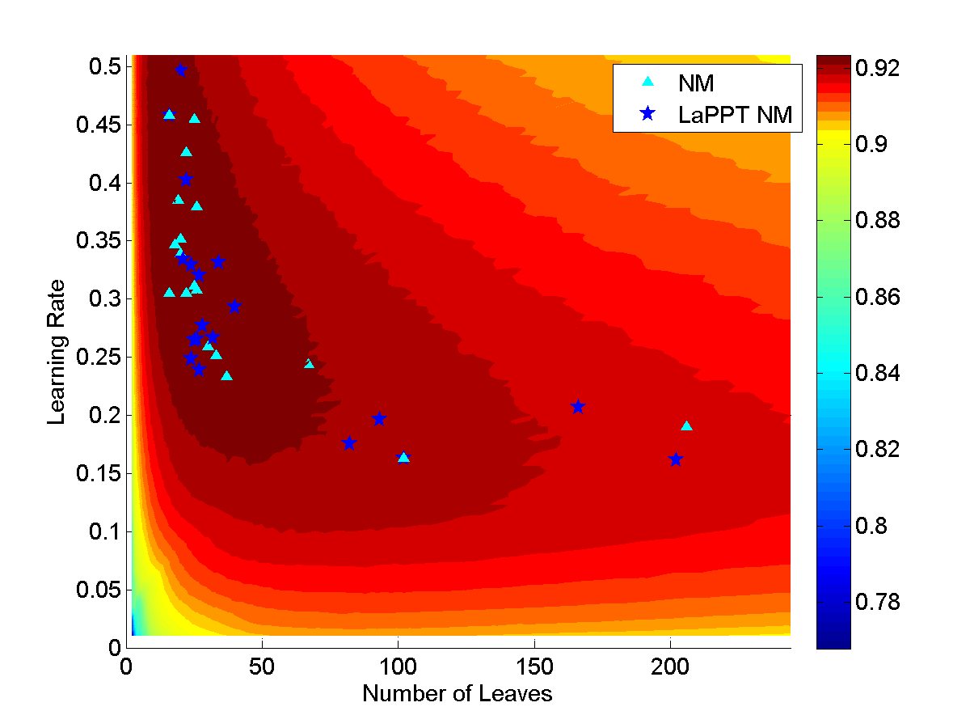
Experiment 3: Optimization quality results
NM-LaPPT finds the same optima as normal NM, but using much fewer evaluations

Slide 29
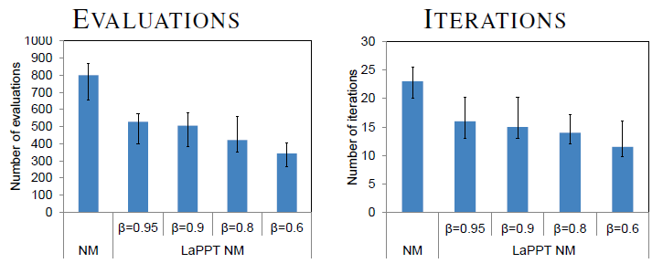
Experiment 3: Efficiency results
Number of evaluations and run time at various false negative rates

Slide 30
Conclusions
Hyper-parameter tuning = black-box optimization
The machine learning black box produces noisy output, and one must make repeated evaluations at each proposed configuration
We can minimize the number of evaluations
Use matched pairwise statistical tests
Perform additional evaluations lazily (determined by power analysis)
Much more efficient than previous approaches on finite space
Applicable to continuous space when combined with Nelder-Mead

